Slide 1
Marketing Indicator 1.01
Understand marketing’s role and function in business to facilitate economic exchanges with customers.
https://www.youtube.com/watch?v=l4seWLW2KhQ

Slide 2
What is Marketing?
Marketing – All activities to get product from manufacturer to consumer that are guided by consumer’s wants and needs
Activities included the 4 foundations of Marketing & the 7 functions of Marketing

Slide 3
Identify marketing activities.
SWOT Analysis
Creating a Marketing Plan
7 Functions of Marketing
4 Foundations of Marketing
Economics - study of allocating resources to maximize their uses
Business, Management, Entrepreneurship - study of operating and managing a business & all the skills and concept necessary
Communication Skills – interacting with people and organizations
Professional Development – ongoing growth within a career path

Slide 4
SWOT

Slide 5
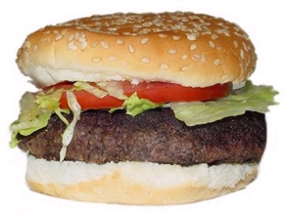
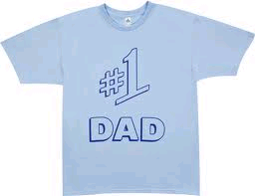
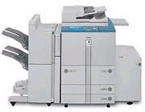
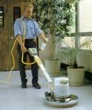
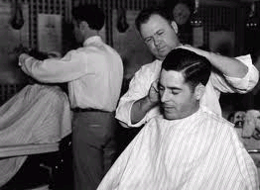
Two categories of products
Goods – tangible purchases
Durable vs. Nondurable
Consumer vs. Industrial
Services – intangible purchases
Consumer vs. Industrial

Slide 6
What can be marketed?
Organizations
Profit vs. Nonprofit
Places
Tourist attractions, Cities
Ideas
People
https://www.youtube.com/watch?v=TubjfUFhecg

Slide 7
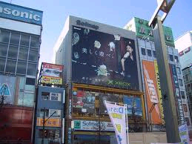
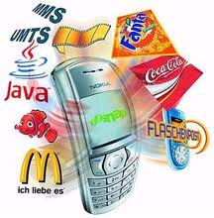
Explain where marketing occurs.
EVERYWHERE!!!!!!!!!!!

Slide 8
Explain the elements of the marketing concept.
Customer Orientation – Business focus on building relationships w/ customers to facilitate loyal, repeat customers for life.
Customer Satisfaction – Meet or exceed customer’s expectations
Customer Needs / Wants – Desires of the consumers that convert into purchases

Slide 9
Explain the elements of the marketing concept.
Company Approach – Employees working together to satisfy their customers to earn profits
Company Commitment – All employees focused on the customers
Company Goals – Goals should be focused on satisfying customers

Slide 10
Explain the elements of the marketing concept.
CRM – (Customer Relationship Management) combines customer information via databases with customer service and marketing communication
Marketing Loyalty Programs – Rewards repeat customers (Grocery store)
https://www.youtube.com/watch?v=jBaPx3sym0I&list=PLCD028CC9138D1BA1
Product – business provides items that satisfy desires of consumers
Profits – Money business keeps after paying all expenses

Slide 11
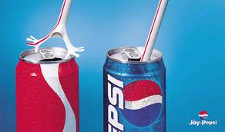
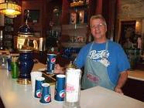
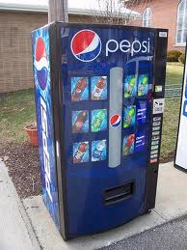
Explain the role of marketing in a private/free enterprise system.
Create awareness of product / service
Have access to product / service
Multiple channels to purchase product / service

Slide 12
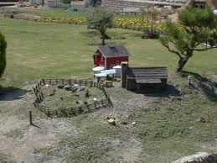
Describe ways in which consumers and businesses would be affected if marketing did not exist.
Society would remain self-subsistence style of living.
Less competition = Higher prices
Less choices, less improvements, less info.

Slide 13
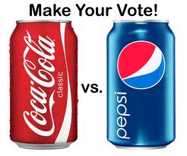
Explain how marketing benefits our society.
Increased competition = Lower prices
Variety of goods
Mass communication about items
Foreign and domestic societies benefit

Slide 14
Explain the purposes of each marketing function.
1. MIM – (marketing information management) provides usable info. to make business decisions. Ex. Surveys to determine preferences of products, develop prototype for testing, implement new process and gather info. about possible problems
https://www.youtube.com/watch?v=LUyJ1gHBBR0

Slide 15
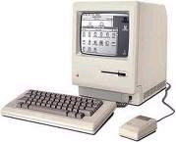
Explain the purposes of each marketing function.
2. Product Service Management – Designing, producing, maintaining, improving, and obtaining products to meet customer’s wants and needs
3. Pricing – Determining a value to charge in order to make a profit
https://www.youtube.com/watch?v=el0rQgN-Lrc

Slide 16
Explain the purposes of each marketing function.
4. Distribution - Transporting, storing, and handling goods from the manufacturer to the consumer. Large impact on pricing due to transportation costs.
5. Promotion - Communication that is used to inform, persuade, or remind customers about a business’s products. (Advertising)

Slide 17
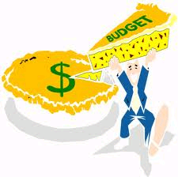
Explain the purposes of each marketing function.
6. Selling - Determining and responding to customer’s needs and wants through personalized communication (face-to-face)
7. Financing – Manage cash needs of a business on a daily basis for future needs. Most businesses struggle the first years.

Slide 18
Explain the interrelationships among marketing functions.
MIM PSM
Pricing Distribution
Promotion Selling
Financing
How do they work together?

Slide 19
ACTIVITY 1
Make a list of all of the goods and services that you have used in the past 24 hours, and respond to the following questions:
How did you come to use these goods/services?
How did you find out about these goods/services?
Where did you obtain these goods/services?
How much did these goods/services cost?

Slide 20
Short Answer Quiz
Give an example of a need and a want.
What is a target market?
Give an example explaining who is a customer and who is a consumer.
The marketing concept philosophy indicates that a business will satisfy the wants and needs of _______________ and still make a profit.
List the two categories of products and give an example of each.

