Slide 1
Marketing Indicator 2.04
Employ product-mix strategies to meet customer expectations.

Slide 2
Product Mix
Product Line
Product Item

Slide 3
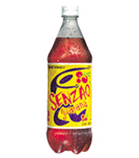
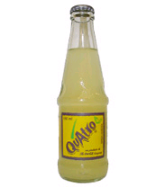
Describe product mix dimensions.
Product Mix – All the types of products a company makes or sells
Some companies have different brands for different markets
Coca-Cola has different drinks for sparkling beverages, water, juice, performance, coffee, tea, and international flavors.

Slide 4
Identify reasons that a business would offer a narrow product mix.
Product Width – number of different product lines
CONTRACTING
Ease on management
Cost effective
Simplicity
Consistency

Slide 5
Identify reasons that a business would offer a broad product mix.
Product Width – number of different product lines
EXPANDING
Reach all markets
Competitive advantage
Ex: Red Lobster specializes in seafood, but offers chicken and steak to broaden their product mix.

Slide 6
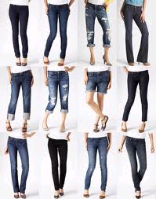
Identify reasons that a business would offer a deep product mix.
Product Depth – number of items offered within each product line
EXPANDING
Variety
Quantity
Ex: Kohl’s carries various quantities of sizes, colors, & styles of Levi Jeans.

Slide 7
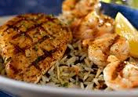
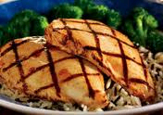
Identify reasons that a business would offer a shallow product mix.
Product Depth – number of items offered within each product line
CONTRACTING
Cost effective
Satisfy small markets
Ex: Only 2 chicken items on Red Lobster’s menu.

Slide 8
Explain the importance of a business’s product mix.
Businesses must plan their product mix carefully because they cannot offer all the products that customers may want.
They should be a profitable market for product offered by a company

Slide 9
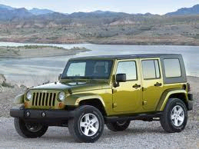
Describe alteration product-mix strategies.
Alteration of Existing Products:
Improve an established product with new design, new package, new uses.
Ex: Jeep offering 4 doors

Slide 10
Describe trading up / down product-mix strategies.
Trading up: Adding a higher-priced product to a line to attract a higher-income market and improve the sales of existing lower-priced products.
Trading down: Adding a lower-priced item to a line of prestige products to encourage purchases from people who cannot afford the higher-priced product, but want the status.

Slide 11
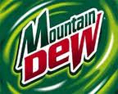
Describe positioning product-mix strategies.
Positioning – actions marketers take to create a certain image of a product in the minds of the customers
In Relation to a Competitor
In Relation to a Product Class or Attribute
In Relation to a Target Market
By Price and Quality
Difficult to change

Slide 12
Identify ways in which product lines can be organized.
Product Line – group of closely related products manufactured by a business
Product Item – specific model, brand, or size of a product within a line
Ex: P&G has over 250 products within 21 product lines
Dish care is a product line
Cascade, Dawn, Joy, & Ivory are items

