Slide 1
SEM1 3.02 A - Promotion
PE - Understand promotional channels used to communicate with targeted audiences.
PI - Explain advertising media used in the sport/event industries.

Slide 2
Define Advertising Media
Advertising Media:
Channels of communication – information travels through them to consumers.
Types of Advertising Media:
Publications
Broadcast Media
Direct Mail
The Web
Out of Home Media
Other Media

Slide 3
Types of Publication Media
Publication (Print) Media
Includes newspapers and magazine that are printed on a regular basis
Types:
Newspapers
Magazines
Journals

Slide 4
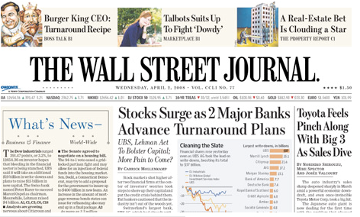
Types of Newspaper Advertising
Based on:
How often they are published: daily, weekly
Their size: broadsheet size, tabloid size
What geographic areas they cover: national, locally
Whom they are intended to target:
Wall Street Journal focuses on business

Slide 5
Print Advertising Advantages & Limitations
Advantages:
Reaches a large audience
Low cost, quick, and easy to produce
Anyone can place an ad, so it is popular among businesses
Variety of advertisement size and pricing
Reaches customers daily
Target a specific geographic market.
Ex: Charlotte Observer and South Charlotte Weekly
Limitations:
Wasted circulation.
Short lifespan. Discarded shortly after reading.
Poorer color and print quality

Slide 6
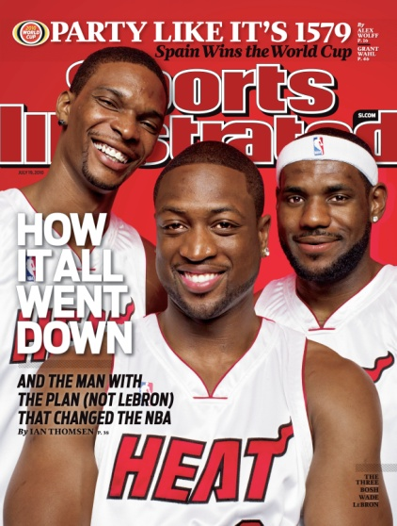
Categorize types of Magazines
Consumer Magazines
Read for personal enjoyment
Target a very specific audience, people who enjoy reading about celebrities, sports, or computer games
People, Sports Illustrated
Business Magazines
Appeal to individuals in all different industries.
Business Week, Fortune

Slide 7
Magazine Advertising Advantages and Limitations
Advantages:
Wider circulation.
Readers tend to keep magazines for a long time.
High quality color and pictures
Target market based on demographics.
Ex: Sports Illustrated for Kids
Target market based on interests. (Psychographic)
Ex: Golf Digest
Disadvantages:
Professional Preparation needed - raising the costs
Lengthy preparation times - information is less timely
Expensive

Slide 8
Types of Broadcast Media
1. Television
Network TV advertising (ABC, CBS, NBC, Fox)
Reaches a very broad audience
Extremely expensive
Cable or Satellite
Targets a more specific audience
Less expensive than network TV
Local
Relatively inexpensive
Highly specific audience
Infomercials: 30-minute commercial (QVC)

Slide 9
Types of Broadcast Media Cont’
Radio
Effective and affordable way to reach your target market
Targets a very specific group of consumers
http://www.youtube.com/watch?v=ofIa8Qcaqt0

Slide 10
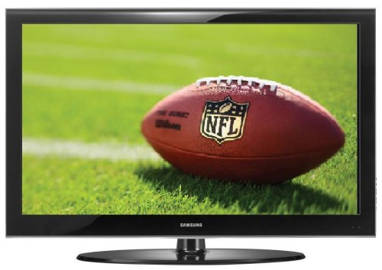
Television Advertising: Advantages and Disadvantages
Advantages:
The experience of color, sound and action makes it believable and easy to remember
TV is the most influential, best-selling type of ad media
Disadvantages:
Very High Costs
Message has short lifespan
Lengthy productions times

Slide 11
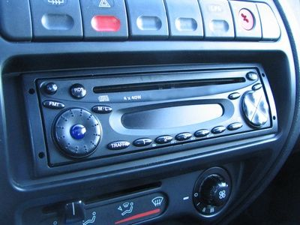
Radio Advertising: Advantages and Disadvantages
Advantages:
Consumers listen in cars, home and at work
Low costs
Short preparation time
Target specific geographic markets
Target specific demographic markets
Ex: Spanish-speaking stations
Target specific psychographic markets
Ex: Sports, Country, Top 40
Disadvantages:
Does not provide a visual impact
Message has short lifespan
Commercial Clutter
I-pods, I-pads, E-books, Cell phones . . . Who is listening to radio?

Slide 12
Types of Direct-Mail Advertising
Direct Mail: Advertising that is distributed directly to the potential consumer through the mail.
Types:
Printed mail
Electronic mail

Slide 13
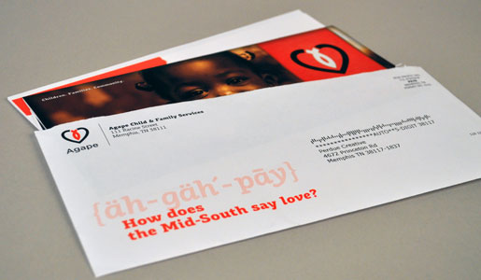
Direct Mail Advertising: Advantages and Disadvantages
Advantages:
Little wasted circulation
Can be very cost effective
Target market can be segmented in many ways
Customer Specific
Personally address the customer
Results are easy to measure
Disadvantages:
Can be considered “junk mail”
Increasing cost of postage

Slide 14
Explain Advertising on the Web
Fastest growing media outlet
Can target a very specific audience
Track user response (who is responding to ads)
Builds brand awareness
Extend advertising reach beyond the local market
To advertise online
Create a company website for customers to learn about the business, contact info, locations and place orders

Slide 15
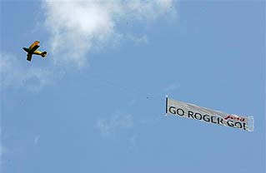
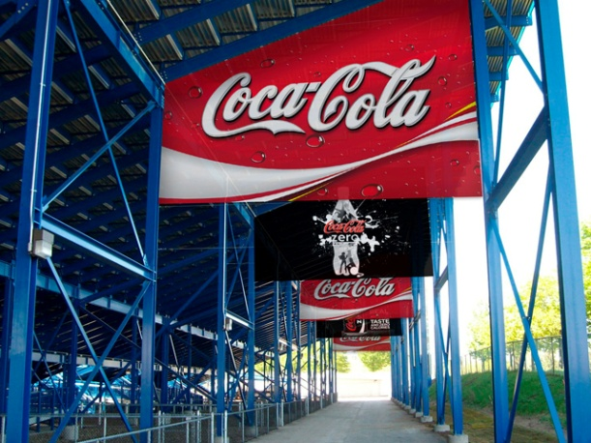
Types of Out-of-Home Media
Any type of message that reaches the customer outside of their home.
Types:
Poster Panels/Billboards
Spectaculars
Transit posters
Indoor billboards
Human directional's
http://www.hongkiat.com/blog/brilliant-creative-billboard-advertisements/

Slide 16
Out-of-Home Advertising: Advantages and Disadvantages
Advantages:
Repetitive Viewing.
Target specific geographic area.
Exposure 24/7.
Disadvantages:
Only a short message.
- Due to low exposure time.
Limited segmentation.

Slide 17
Types of “Other” Advertising
Specialty media remind people about your business
must have business name or logo
Must be useful (pen, baseball cap)
Must be given away
Directory advertising
Informs people about how to contact businesses with a street address or Web address
Movie theater advertising

Slide 18
Types of “Other” Advertising cont’
Product placement
Manufacturers pay millions for the right to use their brand as movie props
Telemarketing
DVD and CD-ROM advertising
Short Messaging Service (SMS): ads over text messages
Smishing: illegal activity that involves posing as a financial institution or other business and sending fraudulent text messages requesting personal infomraiton
Human billboards: ads placed on arms, chests, foreheads, etc.
http://www.google.com/#q=human+billboard

Slide 19
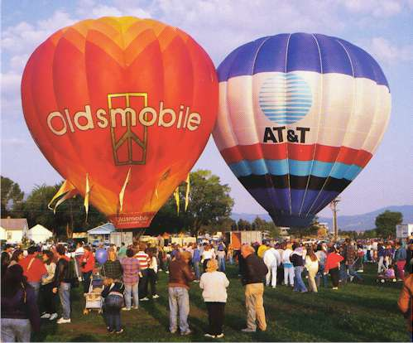
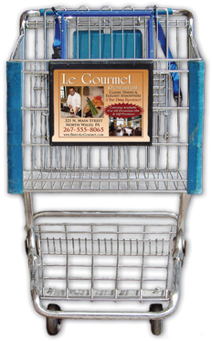
Examples of “Other Media”
http://neadcorp.com/vid/
Grocery store carts
http://www.adventureballoon.com/advertising.htm
Hot air balloons

Slide 20
“Other Promotional” Media
advantages
disadvantages
Reach target market in a friendly, casual manner
Low cost per contact
Market segmentation use is very good
Customization
Message is ignored
Consumers are not focused on your subject matter
May not be your target market consumers
Lack of good method to measure effectiveness

Slide 21
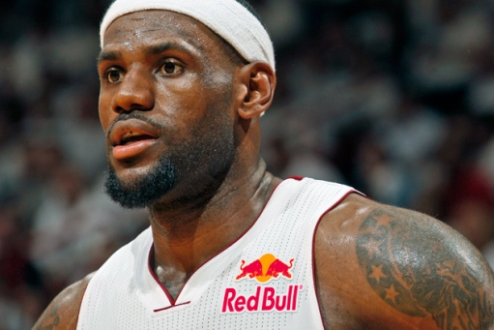
Trends in Advertising Media
Social Media
Twitter and Facebook advertising
Advertising on sports uniforms
NBA Practice Jerseys
Commercials before YouTube Video

