Slide 1
3.03
Explain Components of Advertising

Slide 2
Terms and Purpose
Headline – Most important element of an ad
Purpose: Get attention, Select an audience, and Deliver a complete message
Illustration – Image within an advertisement
Purpose: Convey a message, educate, attract attention
Identification – Identify an item and relate it to a personal experience or a business
Purpose: Make connections with a product

Slide 3
Headline Examples
"Are you guilty of these 7 common dating Sins?" (Creates Curiosity)
"How to get your cooking bragged about“ (Curiosity)
Quick Relief for Tired Eyes“ (Precise Solution)
How to save over 15% on auto insurance before Nov 20th“ (Incentive to Act)

Slide 4
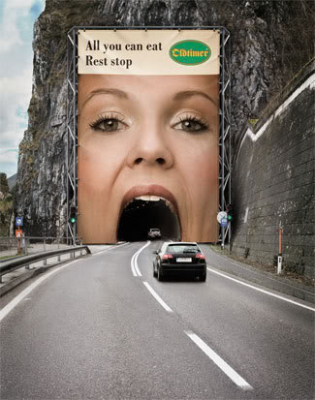
Identify the advertising elements we just talked about:
Headline
Illustration
Identification

Slide 5
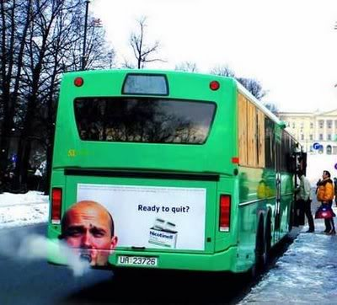
Identify the advertising elements we just talked about:
Headline
Illustration
Identification

Slide 6
Terms and Purpose
Copy – Text of an advertisement that delivers the sales message
Purpose: Catch and hold attention, encourage action, point out product features or uses
Layout – Design of size, color scheme, graphics, object and text placement to send intended message to the target audience
Purpose: Organize information in a logical order
White space – Areas between type and images in a magazine ad or web page, etc., that is blank
Purpose: Attracts attention FIRST, Balances design and helps rest your eyes,

Slide 7
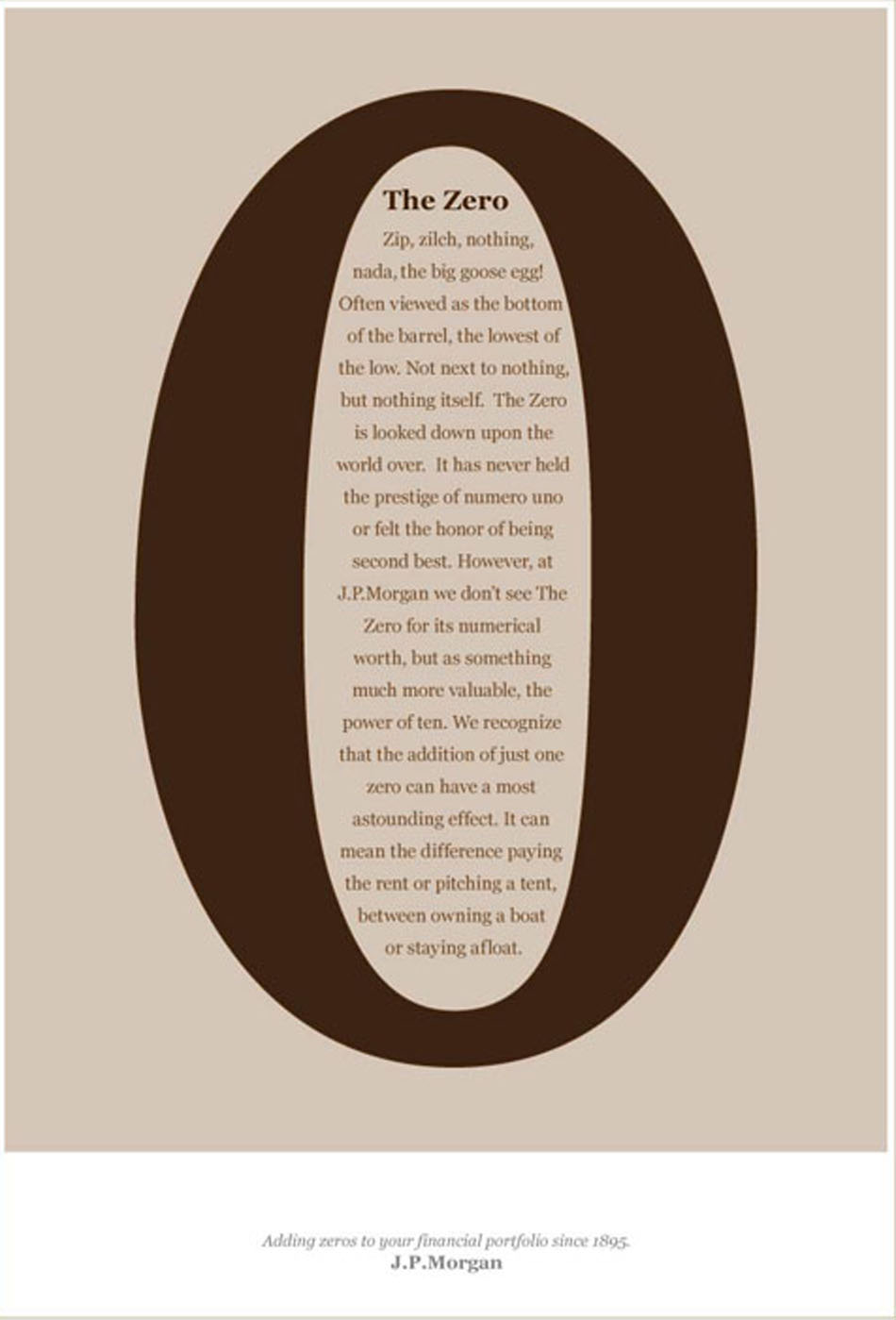

Slide 8
Copy Techniques
Intimidate
limited quantities are available
Qualification Needed
Only a select few will qualify
Guarantees
Money back guarantee if your not satisfied
Repetition
Relieve back pain forever” and then later say “Eliminate back pain permanently”

Slide 9
Layout Examples

Slide 10
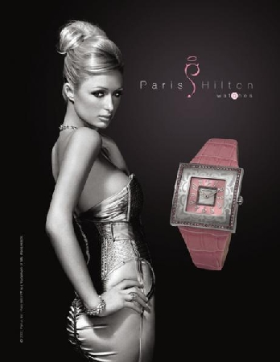
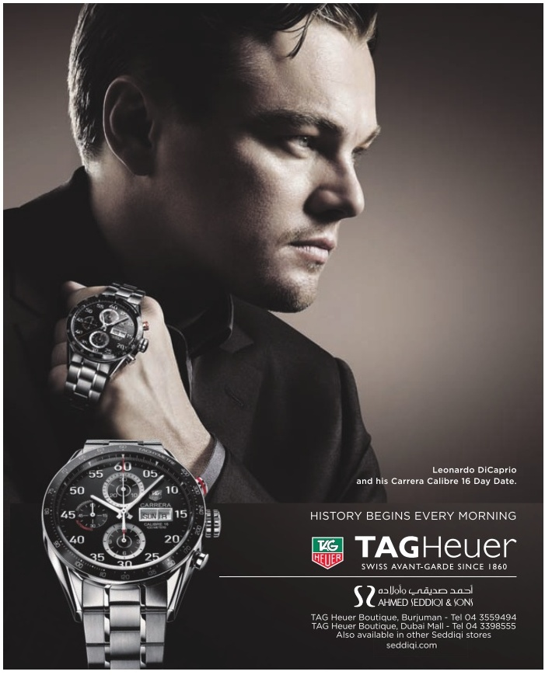
Using Illustrations to Focus Attention
Notes:
When watches are at 10:10, it looks the cleanest and most symmetrical, shows the brand name, or logo, which is usually just below the center of the face. Plus there is a natural line of symmetry which is aesthetically pleasing for the buyer, the clock appears to be smiling, and the ‘V’ shape stands for victory.

Slide 11
Dissecting an Advertisment
http://ezinearticles.com/?Creating-the-Perfect-Advertising-Headline&id=544676

