Slide 1
SEM1 3.04 A - Promotion
PE – Understand the use of direct marketing to attract attention and to build a brand
PI – Explain the nature of online advertising
PI – Discuss types of direct mail tactics

Slide 2
Terms – Online Advertising
Banner ads - embedding an ad into a web page – known as a click through due to interactive actions where the consumer clicks and is taken to the banner ad’s company website
Buttons - smaller banner ad normally used to advertise programs used in creating the site
Pop-up front/under ads - ads that display in a new browser window either in the front or behind the current browser window
Flash ads – adding interactive elements to standard HTML sites
Floating ads- move across a screen or floats above the content

Slide 3
Terms – Online Advertising
Exit pops - when you exit a website a related website opens – can be very annoying
Rich media ads - includes animation or video and have more complex user interaction – Example: ads change when you move your curser over it – a movie sample with streaming video
http://www.patentlyapple.com/patently-apple/2010/05/apple-reveals-a-powerful-location-based-service-for-the-iphone.html
Text ads - advertising using text based hyper links – All website text is written in HTML language
Advergames - video games containing advertisements
Virtual worlds – these are still evolving and have not been that successful – can be used to market a virtual store

Slide 4
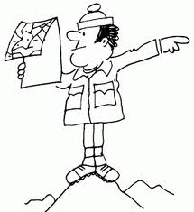
Terms – Online Advertising
Sponsorships – companies that pay to advertise on certain websites in order to be affiliated or recognized - these are becoming more popular as a subtle way to get your message to the consumer
Sponsored search results - ads from companies that may say “brought to you by”
Bookmarks/favorites - collection of direct links to predefined web pages stored in your web browser – called favorites in Internet Explorer
Guides – assists in providing information or a roadmap to the web
E-mail based ads - embedded in or the entire email is an advertisement

Slide 5
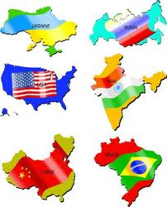
Advantages of Online Advertising
Scalability – ability to function regardless of size
Cost-effectiveness - reasonably priced for advertising
Desirable Demographics
Targeted Audience
Growing Audience
Tracking Capabilities
International/Worldwide Opportunities – market anywhere

Slide 6
Disadvantages of Online Advertising
Consumers may ignore the message
May not reach your intended target market
Some ads may be very expensive
Consumers get distracted – clutter
Too many options
Viewing problems
Copy write issues

Slide 7
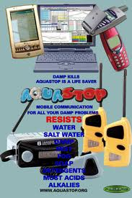
Terms - Mobile Marketing
Mobile Marketing – the use of wireless network & cell phone as a means of marketing communication
SMS (text messaging) – exchange of short text messages between fixed line or mobile phones
MMS (multimedia messaging services)
http://www.youtube.com/watch?v=bgkMpXR6-Nw
Mobile web banner
http://www.youtube.com/watch?v=dqBuw2WGFzA
Mobile web poster

Slide 8
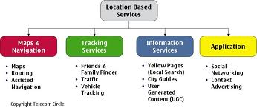
Terms – Mobile Marketing
Mobile advergaming – games on the move – using smart phone games as promotional tools –
http://www.youtube.com/watch?v=J_e8mVFtHm4
Websites – groups of pages on the www. devoted to one or several topics
Location-based services – recommendation of services like restaurants, retailers, events, etc. in an area
Utilizes GPS to locate your and target location
Examples: urbanspoon.com, zagat.com
http://www.zagat.com/
QR codes – web-based software solution to create interactive marketing and promotional campaigns through generation of Quick Response (QR) codes – engage with customers with smart phones in real time response
Mobile search – information retrieval service w/mobile platforms & phones

Slide 9
Terms – Mobile Marketing
Mobile Apps
Mobile redemption
http://www.iloopmobile.com/services/mobile-coupons-with-pos-redemption
Referral rewards
http://go.extole.com/WebsiteSocialReferrals101Guide_ppc.html?gclid=CLnc_MG2ybICFQY3nAodAA0AJg
Mobile videos
http://wasatchmobile.com/index.php?option=com_content&view=article&id=76&Itemid=264
http://www.apple.com/iphone/from-the-app-store/?cid=wwa-us-kwg-features-00001&siclientid=6381&sessguid=58e1991e-872d-434b-be08-5b422a2f4c13&userguid=58e

Slide 10
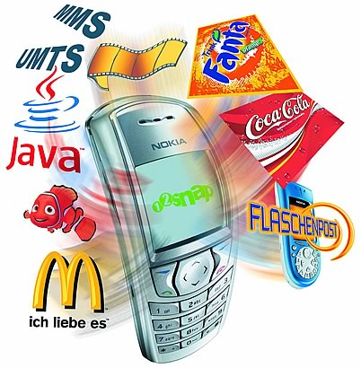
Mobile Marketing
Advantages
Disadvantages
Lower cost
Customization
Easy tracking & response
Not labor intensive
Instant results
Huge viral potential
Micro blogging benefits
Privacy issues
Navigation issues
Viewing issues
Deletion of message
Lack of reliable measurements tools
Platform too diverse & complex

Slide 11
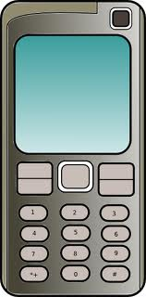
Mobile Marketing
Types of devices used
Mobile phones
Apps
Growth of mobile marketing
Should generate more than $5 billion in sales by 2015
http://www.mediabistro.com/alltwitter/mobile-marketing_b22962
Privacy issues with mobile marketing
Advertisers are wary of privacy issues
FCC has not rules on limiting use and release of customer data, including location information
Users must now agree to have their information released and they can opt out in an easy manner

Slide 12
Banner Ads vs. Rich Media Ads
Banner Ads
Cost effective
Above average click through
Good branding tool
Easy to track
Targeted traffic
Often ignored by consumers
Both are highly interactive
Rich Media Ads
Higher cost to create & maintain
Better click through than normal banners
May be viewed as annoying & intrusive
Use of pop-up blockers may prevent viewing
Ad blindness due to overcrowding

Slide 13
Terms - Direct Mail
Direct Mail – Best method to target specific groups of customers, focus promotional efforts and gain the best results
Collateral Pieces
Letters – Postcards – Catalogs – Self-Mailer
Brochures - Business cards
Technology in direct mail
Miniature samples - Sound - Interactive use of on-line communication – QR codes

Slide 14
Direct Mail
Advantages
Disadvantages
Targeted to your market if well planned
Personalized message but should be brief…
Can be measured by results if you have a “call to action” to encourage the sale
Total control of message
Hidden from your competitors – ambush marketing
Throw – away
High cost of list maintenance
Longer lead time
Expertise required to really hit target market
Can be expensive so not very cost efficient
Difficult to track

Slide 15
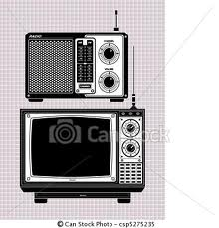
Electronic Media TV & Radio
Most leagues, conferences or teams have national, regional and local arrangements with both broadcast media types
Some have blackout options (TV games must be sold out to have local broadcast) – promotes ticket sales
Some have agreements on additional broadcast rights such as coach and player interviews (before/after/later) games
Teams desire to have this exposure to build their brands and to grow their target markets

Slide 16
Search Engines
Purpose of Search Engines – to provide an international source of information in an organized, systematic manner
Search engines can assist individuals by quickly researching various information groups of interest
Web crawling (search engine spiders) methodically searches the web for HTML text in an automated manner – These spiders will often ignore flash, Java and other items and search for the basic HTML text
Importance of location/top of list
Greater company visibility - Higher level of website traffic
More customer trust in company’s website
More customer focus of company’s value and importance

Slide 17
Search Engines
Advantages
Disadvantages
Can be an effective marketing technique
Targets the right audience
Cost effective
Builds credibility
Large indexes offer wide variety of information
Consumers can clearly define what they seek
Organization of information
Competition
Must make changes to your website code - costly
Takes a while to kick in - slow
Crowded market place
Irrelevant web pages causes frustration of consumers
Takes a learning curve to learn how to navigate properly
PPC (pay per click) can be expensive

Slide 18
Search Engines
Link building and search-engine results
Site optimisation – key words
Site popularity
Link popularity
Contact the major web directories
Use good content
Include press releases and news articles
Examples of link-building strategies
Guest blogging
Offline to online relationships
Forums & online communities
Reach out to locals & professional interests
Use giveaways

