Slide 1
3.04C – Forms of Branding

Slide 2

Forms of Branding
A brand is a design, name, symbol, term or word that distinguishes and identifies a company and/or products or services

Slide 3
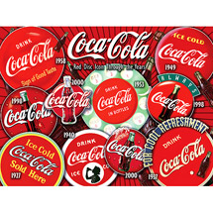

Forms of Branding
A corporate brand represents the entire company or organization
For example, Coca-Cola, Ford, McDonalds, Kraft or Microsoft

Slide 4
Forms of Branding
A product brand represents a specific product of a company or organization
For example, Diet Vanilla Coke, Big Mac, or Windows XP

Slide 5
Forms of Branding
A private distributor brand, also called a store brand
For example, Radio Shack brand of batteries, Lowe’s brand of macaroni and cheese

Slide 6

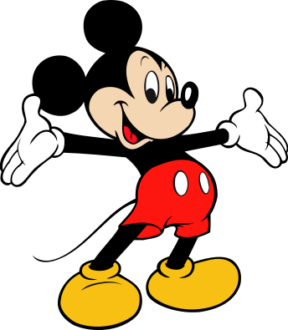
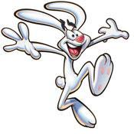

Trade character:
Personified symbol that represents the brand name

Slide 7
Brand Vocabulary
  Competitive Advantage
  Positioning
  Market position
  Brand
  Brand name
  Brand symbol
  Trade character
  Brand recognition
  Brand preference
  Brand insistence
  Product brand
  Generic brand
  National brand
  Private/distributor brand
  Brand strategies
  Family branding
  Slogan
  Individual branding
  Brand extensions
  Brand licensing
  Co-branding
  Brand equity
  Trademark
  Service mark

