Slide 1
SEM1 3.07 A - Promotion
PE – Develop content for use in marketing communications to create interest in product/business/idea
PI – Write e-mail marketing copy
PI – Execute targeted e-mails

Slide 2
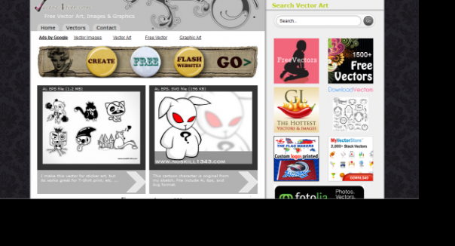
Types of e-mails
Plain text
Easy to create & least expensive
Most common type
Text formatted to be pleasant to the eye
May contain links
HTML
May look like web pages
Supported by multiple e-mails
Longer download time & space
Rich media
Expensive & complicated with video, graphics & sound
Require tech knowledge, extra space and internet

Slide 3
What to consider before
Timing of e-mails
Frequency – daily, weekly, monthly, quarterly
Delivery time – time and date
Distribution methods
Full service firms
Most expensive, suggest target markets, create all content, execute mailings, track results & longer lead time
Hosting services –
Monthly fee based on mailings
In-house –
Cost not tied to mailings, control of all content, can make changes, requires e-mail software or use BCC distribution

Slide 4
What to consider before
Safety/security
Business privacy policy – type of data collected & how the company will use/distribute the data
Include the privacy policy in all emails
Establish trust by being honest and non-threatening
Consider a guarantee or money back policy

Slide 5
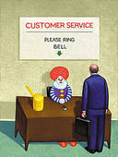
Establish e-mail recipients
Potential customers
Companies will also purchase e-mail lists
Need to make sure recipients are target market
Current customers
Many may opted to receive timely information
Newsletter subscribers
Discussion group members
These are generally interested individuals

Slide 6
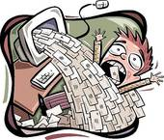
Elements of a marketing e-mail
From
Personalized, clearly identifies sender & error free
To
Personalized, makes recipient feel only sent to them
Subject
Avoid Spam filters – avoid certain types of words
Focus on benefits to the recipient
Catchy, original hook – gain their attention
Marketing copy
Grammatically correct – no typos or spelling errors
Succinct & complete but not wordy

Slide 7
Elements of a marketing e-mail
Marketing Content
Organized, understood and can follow
Ideas are clear and understood by recipients
Offers unique proposition & encourages response
Establishes trust with exact costs & non-threatening
Format – Style - Quality – Consistency
Design complements message with margins & white space
Fonts (size & face) adds to readability
Style is consistent – overall appearance has flair & pleasing to the eye
Size & weight of headings guide the eye
Properly formatted with clear sections, no broken lines & text that fits

Slide 8
Elements of a marketing e-mail
Call to action/response
Response mechanisms built into 1st & last paragraphs
Provides date, location and links for response
Testimonials
Helps to establish trust with the recipients
Reassures the recipient
Marketing links
Works properly & takes recipient to web page offer
Signatures
Complete contact info that is short & simple

Slide 9
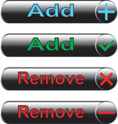
Elements of a marketing e-mail
Request removal link
Clear and specific instructions to request removal
Allows them to change their subscriber information
Privacy statement
Explains the information being collected
Explains how this information will be used/distributed

Slide 10
Targeted e-mail procedures
Create e-mail lists
Select recipients more likely to respond
If possible choose recipients that have signed up
Create a signature
Name, company, contact info, benefit, close
Create the email
Develop personalized, benefit focused & relevant content – subject line must be “catchy” (hook)
Choose an e-mailing distribution technique
BCC – when you do not use software
Bulk e-mail software

Slide 11
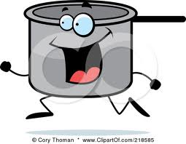
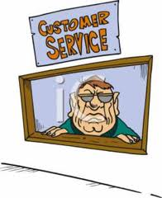
Targeted e-mail procedures
Conduct a test run
Make corrections and test again
Send the email
Manage the distribution list
Delete or fix bad or unwanted addresses
Provide follow-up service
Adequate # of customer service personnel should be able to respond within 24 hours – this can be automated
Track the results
Have customer service ask what prompted the inquiry
Monitor the activity on the web pages targeted by the email

Slide 12
Let’s create 2 SEM e-mails
Students will work independently at home and create 2 emails – One good(s) and one service product
One will be targeted towards recipients that might be interested in purchasing season tickets for the new UNC – Charlotte 2013 football season
One will be targeted towards recipients that might be interested in purchasing a sports or entertainment product (good) of your choice
Follow the rubric to maximize your grade!
Each email must contain at least 2 BRIEF paragraphs
Print each email and bring into class for presentation

