Slide 1
SEM1 3.08 A - Promotion
PE - Manage media planning and placement to enhance return on marketing investment
PI - Determine advertising reach of sport/event media
PI – Calculate media costs

Slide 2
Advertising Reach & Frequency
Reach and frequency are both quantitative measures of advertising – often used to determine costs of media
Frequency is the # of times you wish to expose a targeted audience to your advertisements
Reach is the # of people in a targeted audience exposed to an ad or campaign at least one time during a designated time period
Reach Calculation % is found by dividing the target audience exposed to the ad by the total target audience
Reach % = TA ÷ TTA
Example: The total target audience for the Carolina Tar Heels Football team is 1,500,000 and those exposed during an ad campaign is 375,000
375,000 ÷ 1,500,000 = 25%
So 25% of the total target audience saw the ad at least one time

Slide 3
Advertising Reach & Frequency
Circulation numbers, subscriptions or rating points are best used to determine & calculate reach data
Broad reach – is effective for consumer convenience goods like toothpaste (simple features)
Effective reach - # or % of consumers in a targeted audience exposed to an ad a specific minimum # of times (more appropriate for targeted SEM consumers) WHY?

Slide 4
Media costs – how to determine?
Circulation
is the size of the audience in the media
Is the most significant factor of media costs
Production costs vary a lot across different media
Preferred location of ad
time of ad, (day, night, drive time)
position of ads in print and broadcast media – what shows
Available discounts
size of ad – frequency of purchase - dollar volume
Demographic makeup
narrowly defined audiences demand higher rates
Editorial climate
credibility & prestige may influence consumers reaction to an ad
Reproduction quality
high quality = higher costs

Slide 5
Media costs type – absolute & relative
Absolute cost
What is the total expenditure for an ad
Cost of production
Cost for time and space purchased
Check rate cards found in Standard Rate & Data Service (SRDS) directories for time & space costs
Relative cost
To determine if one media type is more efficient or cost effective over another
Use (CPM) - based on cost per thousand
Often used in print media and internet
Use (CPRP) - based on cost per rating point
Often used in broadcast media and outdoor
Use (GRP) – based on gross rating points across a media platform

Slide 6
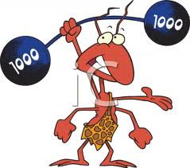
Media costs – how to calculate?
Cost per thousand (CPM)
Multiply cost of the ad by 1000 then divide by the number of people receiving the message (reach)
CPM = (Cost of ad x 1000 ÷ by # of target audience)
Example:
Cost of ad is $50,000
Total audience is 2,000,000
($50,000 x 1000) = $50,000,000
($50,000,000 ÷ 2,000,000) = $25.00

Slide 7
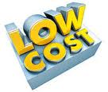
Media costs – how to calculate?
Cost per rating point (CPRP)
Calculated to determine 1% of audience
Cost per gross rating points (GRP)
(GRP) = (Reach (x) frequency) - to determine GRP and 240 GRP’s used as a standard of measurement
The cost per GRP is determined by dividing the total advertising expense by the # of gross rating points
(GRP) cost = (Expenses ÷ GRP)
Example:
Total advertising expense is $20,000
The gross rating points for the show is 210
$20,000 ÷ 210 = $95.24

Slide 8
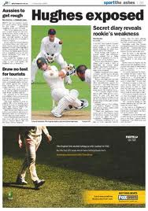
Media costs for different mediums
Newspapers
Rates – how determined
circulation and target market are primary factors – great for locals
less for local ads vs. national advertisers
information given through use of rate cards
Types of rates
Run of page – wherever newspaper places the ad
Flat rates – used for one time placement
Sliding scale rates – more ads will cost less per ad
Combination rates – ads and (FSI) will lower rate
Volume and consistency rates/discounts
Costs
Tend to be lower than other print media
Position preferences
Example: SEM advertiser wants ad placement in sports section instead of food or employment opportunity section
Color requirements or including (FSI) free standing inserts
Split-runs - 2 different ads produced at same time

Slide 9
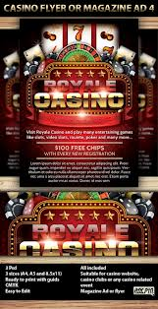
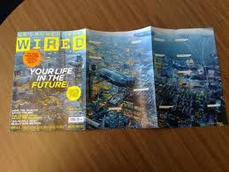
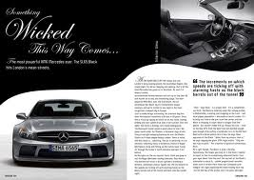
Media costs for different mediums
Magazines
Rates – how determined
Circulation and target market are primary factors for rates that reach specific readers for advertisers
Types of rates
Size and frequency rates
Volume and consistency rates/discounts
Combination rates
Costs
Tend to be higher than other print media
Position preferences – front and back cover, inside front
Color requirements
Full bleed pages
Gatefolds
Spreads

Slide 10
Media costs for different mediums
Television
Most effective way to promote a local event to the public
Very long production lead time
Rates – how determined
Larger/higher audience rating & time are the major factors, (Nielsen ratings) are GRP for television – advertisers will ask for this data
SQAD (cost-per-point) x Nielsen ratings determine TV ad costs
Rates and schedules change based on local factors
Types of rates
Run of schedule – prime time vs. other
National network, cable or local network
Costs
Are higher than any medium
Time availability - morning, afternoon, prime time, late night
Demand for time – peak winter season
Length of ad impact ad & production costs

Slide 11
Media costs for different mediums
Radio
Effective for local & regional markets – use local personalities
Relatively short production lead time – quick turn around
Very good to hit your demographic target market
Rates, how determined
Audience size & composition are the major factors (Arbition)
Less than TV but can still be expensive
Type of rates
Offer the largest discounts of any medium
Run of schedule – (all 3 types lower costs)
Weekly package (TAPs) total audience plans
Volume and consistency rates/discounts
Costs
Are lower than TV media
Time availability – morning/evening drive
Production costs & ad
http://www.bestradiocommercials.com/?gclid=CN64k8z73bICFQsFnQodMH8AtA

Slide 12
Media costs for different mediums
Internet
Very popular 3rd to television and newspaper
Rates – how determined
Web-site popularity - browser
Types of rates
CPM – cost per 1000 impressions
CPC – cost per click
Cost
E-mail ads may be very cost effective
Creative type – text, image, multimedia
Size – banner, pop-up etc.
Placement in browsers
Delivery type

Slide 13
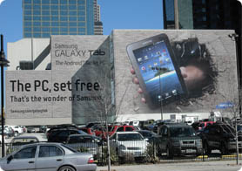
Media costs for different mediums
Out-of-home (outdoor and transit)
Rates – how determined
Audience size based on ad’s visibility, its location and population in area
Types of rates
http://clearchanneloutdoor.com/rates/
Costs
Size of space
Length of time
Illumination/movement/3D
Production costs - varies
Types of out-of-home
Painted bulletins – Spectaculars (as seen here) - Transit advertisements like subway, cabs, hot air balloons or busses
Moveable billboards – very good at promoting an event throughout a metropolitan area – draws a lot of attention and is seen by a lot of consumers

Slide 14
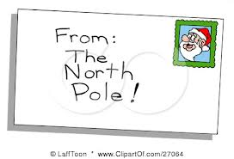
Media costs for different mediums
Direct Mail
Rates – how determined
Vary based on what you wish to accomplish
Types of rates
Allows advertisers to target a specific market with the most cost effective manner but preparation time is longer than radio and newspaper ads
Costs
Postage and delivery rates
Production costs
Mailing list costs
Labor costs
Total costs can vary and at time be very expensive

Slide 15
SEM1 3.08 A - Promotion
PE - Manage media planning and placement to enhance return on marketing investment
PI – Select advertising media
PI – Buy ad space/time

Slide 16
Selecting advertising media - why
Selection of media is important because it is the largest expenditure of an ad budget
Choosing the most cost effective is essential to provide the most effective ad campaign
Must select the medium(s) that reaches the target market

Slide 17
Factors impacting your media selection
Objectives
Your overall goal of advertising
Target audience
Identify their media-usage habits
You limit waste circulation
Competition
Most will use the same media so look for alternatives
Budget
Most companies will have constraints that impact your selection- you can’t do everything you want

Slide 18
Factors impacting your media selection
Product
Nature of product
Colorful or luxurious may need demonstrating resulting in media selection – TV or magazines
Other products need different requirements
Provide examples for each media type
Distribution
Location, place or geography
Coverage should be same as product availability
Lead time
Television and magazines require the longest
Daily newspapers and radio require the least time

Slide 19
Factors impacting your media selection
Quantitative media factors
Measured numerically
Different methods and types and believed the most important factor
Measure cost efficiency
Total cost (varies by medium)
Cost per person (reaching potential prospects)
Advertisers use CPM, CPRP and GRP
Qualitative media factors
Not as easy to measure as quantitative
Credibility
Medium’s believability to consumers – take seriously
Editorial environment
Each type appeals to a specific group of consumers
The climate or mood of the media vehicle should compliment product
Level of clutter can impact your ad – less is more
The impact – impression an ad will make on the target market consumer

Slide 20
Factors impacting your media selection
Media coverage
Extensive coverage
Reaching a large audience and exposing them at least once to your advertisement (reach)
Example: Advertising during The Super Bowl
Intensive coverage
Reaching a smaller audience more often to drive home the message (frequency)
Example: Multiple Renaissance Festival advertisements in newspaper, radio and TV in the Charlotte market

Slide 21
Buy advertising space/time
Research
Choose a medium/media type to reach your goals
Contact advertising manager
Request information
Rate cards
Circulation and/or rating numbers
Analysis & strategies
Determine all costs for your promotional strategy
Make sure you can reach your target market
Planning
Advertising message
Pre-production process
Negotiating
Go for the numbers (CPM)
Adequate reach & frequency
Review rating services
Negotiate the best price
Scheduling
Time of day - placement
Geographic location
Reach & frequency
Placement of ads
Confirmation of ad run
Payment
Evaluation
Review for effectiveness
Propose additional strategies

Slide 22
SEM1 3.08 A - Promotion
PE - Manage media planning and placement to enhance return on marketing investment
PI – Choose appropriate media vehicles for sport/events

Slide 23
Choosing media vehicles
Determine the problem
Advertising goals
Primary target audience
Competition
Consider potential media options & total costs
List all media and analyze effectiveness and costs
Select the appropriate media and vehicles
Review quantitative and qualitative factors
Select one that has right time, place & audience

Slide 24
Choosing media schedule strategies
Determine the timing and schedule strategies
Select degree of continuity desired
Should be chosen based on advertiser’s needs and type of product
Continuous strategy – ads on a regular basis
Good for everyday products like groceries
Flighting strategy – intermittent scheduling
Great for seasonal promotions like events
Great for introducing new products or events
Pulsing strategy – combination, low then high
Good for reminding consumers about your product
Coca Cola uses this strategy

