Slide 1
4.01 (PR: 003) Acquire a foundational knowledge of promotion to understand its nature and scope. Performance Indicator (PR:003). Identify the Elements of Promotion

Slide 2
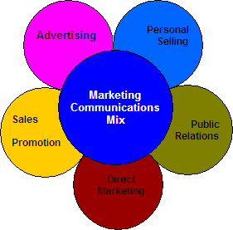
Identify the elements of the promotional mix.
The promotional mix—made up of advertising, personal selling, publicity, and sales promotion—plays a key role in obtaining customers. It increases brand recognition, raises product awareness, and communicates product benefits.

Slide 3
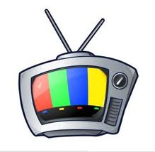
Advertising – Involves non-personal, mostly paid promotions often using mass media outlets to deliver the marketer’s message.
Advertising media:
Television Radio
Print Publications Internet
Direct Mail Signage
Product Placement Mobile Devices
Sponsorships Other Media Outlets

Slide 4
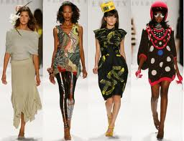
Sales Promotion – Involves the use of special short-term techniques, often in the form of incentives, to encourage customers to respond or undertake some activity.
Displays Coupons
Demonstrations Instant rebates
Free samples Fashion shows
Contests Novelty items
Trade shows Exhibits

Slide 5
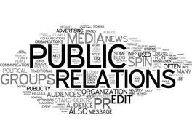
Public Relations – Also referred to as publicity, this type of promotion uses third-party sources, and particularly the news media, to offer a favorable mention of the marketer’s company or product without direct payment to the publisher of the information.

Slide 6
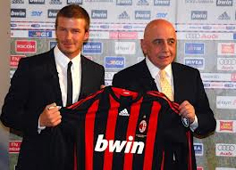
Examples of Public Relations
Favorable news release
Appearance on a TV talk show
Feature article
Press conference
Internet newsgroup, bulletin board, or web site
Mention of charitable activities in print or broadcast media

Slide 7
Personal Selling
As the name implies, this form of promotion involves personal contact between company representatives and those who have a role in purchase decisions (e.g., make the decision, such as consumers, or have an influence on a decision, such as members of a company buying center).
Often this occurs face-to-face or via telephone, though newer technologies allow this to occur online via video conferencing or text chat.

Slide 8
Categorize examples of promotions according to the elements of the promotional mix.

Slide 9
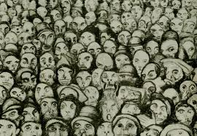
Mass vs. Targeted
Promotions can be categorized based on the intended coverage of a single promotional message.
For instance, a single television advertisement for a major sporting event, such as the Super Bowl, World Cup or Olympics, could be seen by millions of viewers at the same time. Such mass promotion, intended to reach as many people as possible, has been a mainstay of marketers’ promotional efforts for a long time.

Slide 10
Today’s marketers are turning to newer techniques designed to focus promotional delivery to only those with a high probability of being in the marketer’s target market. For example, Google, Yahoo and other Internet search engines employ methods for delivering highly targeted ads to customers as they enter search terms.

Slide 11
Personal vs. Non-Personal
Personal Promotion: Promotions involving real people communicating with other people is considered personal promotion.
While salespeople are a common and well understood type of personal promotion, another type of promotion, called controlled word-of-mouth promotion (a.k.a., buzz marketing), is emerging as a form of personal promotion.

Slide 12
One key advantage personal promotions have is the ability for the message sender to adjust the message as they gain feedback from message receivers (i.e., two-way communication).

Slide 13
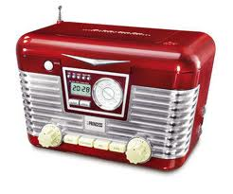
Many non-personal forms of promotion, such as a radio advertisement, are inflexible, at least in the short-term, and cannot be easily adjusted to address questions that arise by the audience experiencing the ad.

Slide 14
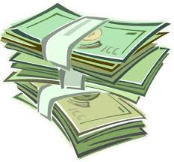
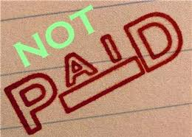
Paid vs. Non-Paid
Most efforts to promote products require marketers to make direct payment to the medium that delivers the message.
For instance, a company must pay a magazine publisher to advertise in the magazine.

Slide 15
There are several forms of promotion that do not involve direct payment in order to distribute a promotional message.
While not necessarily "free" since there may be indirect costs involved, the ability to have a product promoted without making direct payment to the medium can be a viable alternative to expensive promotion options.

Slide 16
Message Flow: One-Way vs. Two-Way
Promotions can be classified based on whether the message source enables the message receiver to respond with immediate feedback. Such feedback can then be followed with further information exchange between both parties.

Slide 17
Demand Creation: Quick vs. Lagging
When a marketer is looking to increase demand, certain promotional activities offer advantages in turning exposure to promotion into a quick increase in demand. Ex. Shark Tank
In general, these activities are most effective when customers are offered an incentive to make the purchase either in a monetary way (e.g., save money) or in psychological way (e.g., improves customer’s perceived group role or status level).

Slide 18
Message Control: Total vs. Minimal
Most promotions are controlled by the marketer who encodes the message (or hires specialists such as advertising agencies to create the promotion) and then pays to have the message delivered.

Slide 19
Message Credibility: High vs. Low
The perceived control of the message can influence the target market’s perception of message credibility.
For example, many customers viewing a comparative advertisement in which a product is shown to be superior to a competitor’s product may be skeptical about the claims since the company with the superior product is paying for the advertisement.

Slide 20
Yet, if the same comparison is mentioned in a newspaper article it may be more favorably viewed since readers may perceive the author of the story has possessing an unbiased point-of-view.

Slide 21
Element | Advertising | Sales Promotion | Publicity | Personal selling
Direct coverage | Mass and targeted | Mass and targeted | Mass | Targeted
Interaction type | Non-personal | Non-personal and personal | Non-personal | Personal
Message flow | Communication mostly one-way but can also be two-way. Inflexible | Communication mostly one-way but can also be two-way. Mostly inflexible | Communications is one-way. Inflexible | Communications is only two-way, no one-way. Flexible
Payment | Paid | Paid | Non-paid | Paid
Demand creation | Lagging | Quick Think about a coupon with an expiration date a month from today. Customer must act quickly in order to save. | Lagging | Quick
Message control | Good | Good | Poor | Very good
Message credibility | low-medium | low-medium | high | medium-high

Slide 22
Describe the importance of the promotional mix.
Plays a key role in obtaining customers
Enables businesses to communicate effectively with consumers
Promoters are able to inform potential customers about the existence of goods, services, images, and or ideas
Promoters are able to persuade customers to buy their products or have certain opinions about their products
Promoters are able to change their promotional mix in order to keep their customers

Slide 23
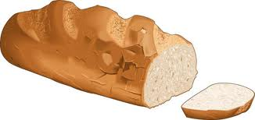
Identify factors affecting the promotional mix.
Good, service, image, or idea:
Product types
Convenience goods are items such as bread, toothpaste, and light bulbs. Items are purchased frequently and with minimal effort.

Slide 24
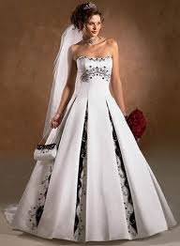
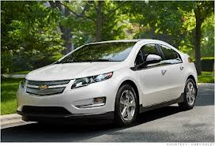
Shopping goods are items such as automobiles, or items that may require the customer to “shop around,” checking prices, styles, colors, qualities, or make other comparisons for the best buy.
Specialty goods are products that have unique characteristics which are prized by the customer. The customer makes a special effort to acquire them.

Slide 25
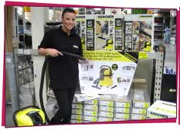
Product Nature
If product is highly technical, requires demonstrations, expensive, or requires installation then Personal Selling should be emphasized
Products that are inexpensive and tend to be self-service should rely on advertising and sales promotion.

Slide 26
Stage of life cycle
Introductory stage: promotional efforts are designed to inform customer about the new existence of the product
Growth stage: Competing products appear on the market and companies must spend promotional efforts on pointing out differences among products. Advertising is used extensively.

Slide 27
Maturity stage: product is well established. Promotion is used to remind customers of the benefits of the product.
Declining stage: Newer products are entering the market. Little money is used in the promoting of this products. At this point it is all about maintaining a positive image for the company.

Slide 28
Product's company
Historical perspective. Many companies rely on previous promotional efforts to determine newer promotional efforts.
Available funds. A key factor in the selection of a promotional mix is the amount of money available for promotion.

Slide 29
Businesses that allocate small amounts of money for promotion, such as a small bookstore or gift shop, tend to rely on local advertising and sales promotions, while businesses that allocate large sums of money for promotion—think Wal-Mart, the Gap, and McDonald’s—can effectively use national advertising.

Slide 30
Competition. In many cases, competing businesses use very similar promotional mixes. This can be attributed to the fact that many factors affecting the promotional mix will have the same or similar effects on all businesses within the same industry. Competing businesses also tend to follow the leader. For instance, when one restaurant offers free meals for children, you can expect competitors to follow suit.

Slide 31
Product's target market
This is the particular group of customers a business seeks to attract
Type of consumer
Used primarily by personal consumer market, the promotional mix should emphasis advertising, sales promotion, and publicity.
Used primarily by industrial market, personal selling must be emphasized.
Number of consumers
If a product has a few consumers, then it should be promoted by personal selling. (Can you think of such a product)?
If a product has many consumers, then advertising and sales promotion can be used.
Geographical location
If a group of consumers live close together, then personal can be used.
If consumers are spread out over a wide area, then advertising and sales promotion can be used.

Slide 32
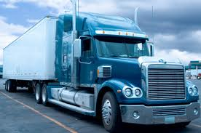
Distribution channel
All products move from the producer to consumers through paths, or channels.
Promotional mix selection is affected by the path a product takes.
If there are many intermediaries or middlemen, between the manufacturer and the consumer, more personal selling is used.
With a direct distribution channel (manufacturer to consumer, no middlemen) personal selling and advertising works well together.

Slide 33
Describe how the product being sold affects the promotional mix.
Product – Different products require different promotional approaches.
For the consumer market, products falling into the convenience and shopping goods categories are likely to use mass market promotional approaches while higher-end specialty goods are likely to use personalized selling.
Products that are complex and take customers extended time to make a purchase decision may require personal selling rather than advertising. This is often the case with products targeted to the business market.
Products pass through different stages in the Product Life Cycle. As a product moves through these stages the product itself may evolve and also promotional objectives will change. This leads to different promotional mix decisions from one stage to the next.

Slide 34
Explain how the product's market affects the promotional mix.
Target Market – As one might expect, customer characteristics dictate how promotion is determined. Characteristics such as size, location and type of target markets affect how the marketer communicates with customers.
For instance, for a small marketer serving business markets with customers widely dispersed, it may be very expensive to utilize a sales force versus using advertising.

Slide 35
Discuss how the distribution system affects the promotional mix.
Distribution –Marketing organizations selling through channel partners can reach the final customer either directly using a pull promotion strategy or indirectly using a push promotional strategy.
The pull strategy is so named since it creates demand for a product by promoting directly to the final customer in the hopes that their interest in the product will help "pull" more product through the distribution channel.

Slide 36
The push strategy uses promotion to encourage channel partners to stock and promote the product to their customers. The idea is that by offering incentives to channel members the marketer is encouraging their partners (e.g., wholesalers, retailers) to "push" the product down the channel and into customer’s hands.

Slide 37
Explain how the product's company affects the promotional mix.
Promotional Objective – As we discussed, there are several different objectives a marketer may pursue with their promotional strategy. Each type of promotion offers different advantages in terms of helping the marketer reach their objectives. For instance, if the objective of a software manufacturer is to get customers to try a product, the use of sales promotion, such as offering the software in a free downloadable form, may yield better results than promoting through Internet advertising.

Slide 38
Availability of Resources – The amount of money and other resources that can be directed to promotion affects the marketer’s choice of promotional methods. Marketers with large promotional budgets may be able to spread spending among all promotion options while marketers with limited funds must be more selective on the promotion techniques they use.

Slide 39
Company Philosophy – Some companies follow a philosophy that dictates where most promotional spending occurs. For instance, some companies follow the approach that all promotion should be done through salespeople while other companies prefer to focus attention on product development and hope word-of-mouth communication by satisfied customers helps to create interest in their product.

