Slide 1
What is Promotion?

Slide 2
What is promotion?
There are two forms of promotion
Product
Institutional
It is important to our economy
Billions of dollars are spent on promotion and promotion activities provide millions of people with jobs.

Slide 3
Product Promotion
An action taken by a company's marketing staff with the intention of encouraging the sale of a good or service to their target market
For example, product promotion performed by a typical business might take the form of advertising the product in print or Internet ads, direct mail or e-mail letters, trade shows, telephone and personal sales calls, TV and radio ads, billboards, posters and flyers.
Some time a one time announcement of it sale
Half price today only!!!
http://www.youtube.com/watch?v=rUbWjIKxrrs

Slide 4
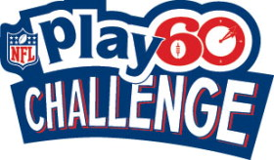
Institutional Promotion
A marketing approach that demonstrates the goodwill of an organization or individual in order to boost its public relations appeal
For many business operators, engaging in active institutional promotion is considered a form of advertising that can increase both brand recognition and overall goodwill
http://www.youtube.com/watch?v=TKphr02LRZ0
http://www.youtube.com/watch?v=IYuUUivRRq0

Slide 5
Types of Promotion
Advertising
Publicity
Sales Promotion
Personal Selling

Slide 6
Advertising
It is paid for.
One set format to carry a message, rather than a personal, one-on-one message.
Identifies the sponsor of the message.

Slide 7
Publicity
Builds a business’ image.
Publicity is free.
Not much control over the message being sent to the public.

Slide 8
Sales Promotion
Usually involves short term activities.
Offers some type of incentive to make a purchase.
Can be successfully used in all channels of distribution.

Slide 9
Sales Promotion (con’t)
Types of Promotions
Trade Promotions
Slotting Allowances
Buying Allowances
Trade Shows and Conventions
Sales Incentives
Consumer Sales Promotions
Licensing
Promotional Tie-Ins
Visual Merchandising and Displays
Premiums & Incentives
Product Samples

Slide 10
Personal Selling
The responsibility of sales personnel.
Order - taking personnel
Order - getting personnel
The most flexible and individualized type of promotion available.
Typically used for more complex or technical products

Slide 11
The Concept of the Promotional Mix
Important to achieve promotional goals.
Decide on the promotional mix that will be most effective in persuading customer or other businesses to purchase and support the businesses products.

Slide 12
Publicity
Type of promotion that relies on public relations effect of a news story carried usually free by mass media.
The main objective of publicity is not sales promotion but creation of an image through editorial or 'independent source' commentary.
Good vs. Bad
http://www.youtube.com/watch?v=09NTUwp1s6U

Slide 13
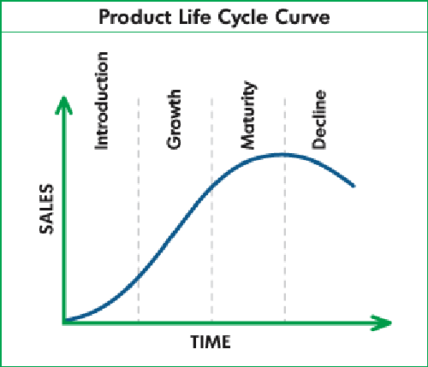
Product Life Cycle

Slide 14
P.L.C.
Introduction stage: stimulate consumer interest and create awareness.
Growth stage: stress benefits of a product over its competitor’s products.
Maturity stage: repositioning a product.
Decline stage: greatly reduce marketing or drop product due to poor sales.

Slide 15
Follow The Leader
Compete ting Companies within the same industry usually react to each others promotion mix by playing follow the leader.
Nike –Lebron James
Adidas- Derrick Rose
http://www.youtube.com/watch?v=r30IPbdWqSw

Slide 16
Materialism
Interest in and desire for money, possessions, etc., rather than spiritual or ethical values
Advertisements reinforce this concept by saying you can increase your social status by purchasing a certain product
http://www.youtube.com/watch?v=V6kfWoW44ME

Slide 17
Stereotyping
Today's television ads are full of inept dads, dumb jocks and clueless husbands and the women who rescue, seduce and nag them. Some see these ads as harmless, while others decry the gender stereotypes they reinforce.
http://thekojonnamdishow.org/shows/2012-02-02/gender-stereotyping-tv-ads

Slide 18
Technology in Advertising
Information can be communicated by more venues and messages can be customized
http://www.youtube.com/watch?v=ibhnRz9Ykr0
Individualized Messages
Cell phone, e-mail, twitter, facebook, I phone

Slide 19
Regulations
Laws vary by country
Children are impressionable and wrong kinds of advertisements can effect their development

