Slide 1
SEM1 1.01 A - Professional Development
PE - Acquire information about the sport/event industry to aid in making career choices
PI - Discuss the nature of the sports/event industries
PI - Describe the impact of sports/events on communities

Slide 2
Types of Businesses in SEM
Franchises
Security
Advertising
Sporting Goods
Venue Management
Media
Notes:
Kaser, K. & Oelkers, D.B., (2001). Sports and entertainment marketing [pp. 9,
14-17, 18-22]. Mason, OH: South-Western

Slide 3
Variety of Sports Available
Professional Teams
Professional Individual Sports
Collegiate/Scholastic Teams
Venues: Coliseums, Arenas, Speedways
Health Clubs
Recreation
Camps
Amateur Sports

Slide 4
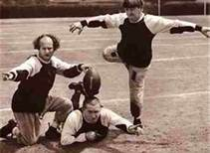
Professional Teams
Basketball: Charlotte Bobcats
Football: Carolina Panthers
Hockey: Carolina Hurricanes
Baseball: St. Louis Cardinals

Slide 5
Professional Individual Sports
PGA
World Tennis Association
PBA

Slide 6
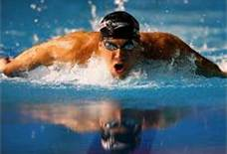
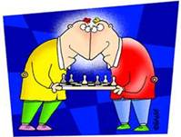
Professional Individual Sports
Running
Swimming
Golf
Bowling
Tennis
Poker
Chess
https://www.youtube.com/watch?v=PeOMLxYbpPE

Slide 7
Collegiate and Scholastic Teams
Virginia Tech
University of North Carolina
NC State

Slide 8
Venues: Arenas, Stadiums, Coliseums, Speedways
Time Warner Arena
Charlotte Motor Speedway
Bank of America Stadium

Slide 9
Health Clubs
Sports & Fitness
YMCA
Curves for Women

Slide 10
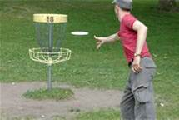
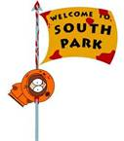
Recreation
Aerobics
Soccer
Basketball
Swimming
Softball/baseball
Frisbee Golf
Area parks

Slide 11
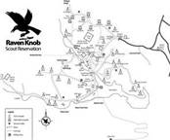
Camps
Tennis Camp
Basketball Camp
Softball/baseball Camp
Raven Knob

Slide 12
Amateur Sports
AAU-Amateur Athletic Union
ASA – Amateur Softball Association
Little League Baseball
https://www.youtube.com/watch?v=Y_L7RAWKr6A

Slide 13
Variety of Entertainment/Events Available
Music
Television
Video Games
Movies/Film Festivals
Fine Arts
Casinos
Theme Parks
Radio Industry
Publishing Industry

Slide 14
Music Industry
Maverick Records
Capitol Records
Cash Money Records/Universal
Quincy Jones

Slide 15
Movie Industry
Warner Brothers
DreamWorks Studio
Disney
Universal
Actors

Slide 16
Theme Parks
Six Flags Magic Mountain
Wet’n Wild Water Park
Carowinds Theme Park
https://www.youtube.com/watch?v=2sWM9EG01iQ

Slide 17
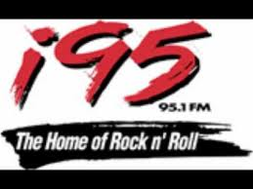
Radio Industry
FM
AM
Country
Rap
Hip-hop
Alternative/Indie
Jazz
Sirius/XM satellite radio

Slide 18
Film Industry
Sundance Film Festival
RiverRun Film Festival
Tribeca Film Festival
Cannes Film Festival

Slide 19
Dramatic Arts Industry
The Little Theatre
National Black Theater Festival
Belk Theatre

Slide 20
Television Industry
Scripted shows
Reality shows
News
Sports

Slide 21
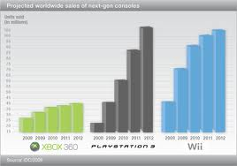
Video Game Industry
X-Box
Wii
PlayStation 3

Slide 22
Fine Arts and Science Industry
Smithsonian Museum
Sci Works
Comic Con

Slide 23
Literacy Industry
Library
Internet
Books

Slide 24
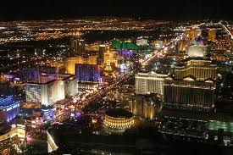
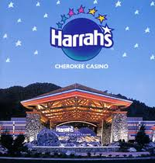
Casinos Industry
Las Vegas
Atlantic City
Harrah’s
https://www.youtube.com/watch?v=MzhlV6Dzvus

Slide 25
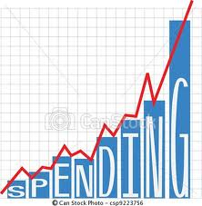
Factors Contributing to the Growth of SEM
Increase of participants in sports/entertainment
Increase of followers of sports/entertainment
Increase in attendance in sports/entertainment
Increase of media coverage
Internationalization
Notes:
Lindauer, Chris. "History and Evolution of SEM." sportscareerconsulting.com. Sports Career Consulting, 17 Dec 2005. Web. 20 Aug 2010. <http://www.sportscareerconsulting.com/request.php?772>.

Slide 26
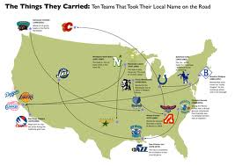
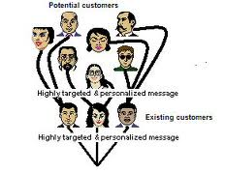
Trends in Sports & Entertainment
Sports:
Naming Rights
X-Games
Sport Specific Channels
Labor Issues
Teams Moving
Multi Uniforms
Entertainment
Internet Web Casts
Event marketing
Specific Channels
Viral Marketing
WiFi
Smart Phones/Music
You Tube
Blue Ray – 3D films

Slide 27
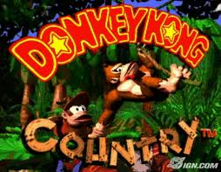
Trends
Organizational Control of Athletes
Internationalization
Branding
Brand Extensions
New Media
Better Research
Nostalgia
Notes:
Kayhle, Lynn. "Sports And Special Events Marketing." Marketing Power. American Marketing Association, 2007. Web. 20 Aug 2010. <http://www.marketingpower.com/Community/ARC/Pages/Connections/SIGs/SportsandSpecialEventsMarketing/Trends.aspx>.
Pics: http://www.strayboots.com/userfiles/image/espn_logo(1).jpg
http://shanebaiotto.com/images/logos_images/logo_full/nfl.gif

Slide 28
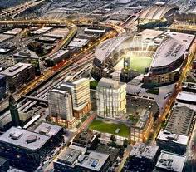
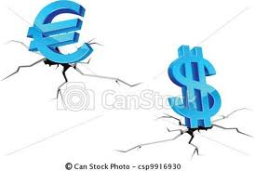
SEM Contributes to Economic Well-Being of Communities
Increase in local business, job creation and increased consumer spending (Direct Impact)
Contribute to tax base (Fiscal Impact through taxes)
Bring business to abandoned areas
Notes:
Kaser, K. & Oelkers, D.B. (2001). Sports and entertainment marketing [pp. 30, 36-37]. Mason, OH: South-Western.
Kern, W.S. (2000). The economics of sports [chapter 1]. Retrieved Aug 23, 2010 from http://www.upjohninst.org/publications/ch1/kern-sports.pdf
Pic: http://de.academic.ru/pictures/dewiki/67/CamdenYards_2005-05-08.jpg

Slide 29
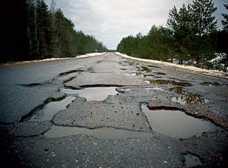
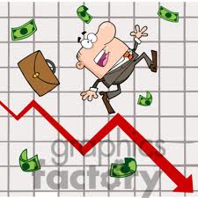
Negative Impacts of SEM on Community
Questionable impact on tax revenue???
Divert resources from other priorities (education, roads, public safety)
Community can be "held hostage" by a team
Notes:
http://www.chriscreamer.com/images/logos/6/256/full/3097.gif

Slide 30
How Communities Foster Positive Results From Hosting Events
Escape from day-to-day life – provides health entertainment and achievement benefits
Strong public image/team unity – attracts additional tourists from outside area
Multiplier effect throughout city
Offers spectators & participants various events to view or engage
Notes:
Shank, M.D. (2002). Sports marketing: A strategic perspective [2nd ed.] (pp. 85-86). Upper Saddle River, NJ: Prentice Hall.
Pic: http://www.travelstripe.com/images/crowd-at-lyon-world-cup-rugby-match1.JPG

Slide 31
How Communities Can Minimize Negative Impact of Hosting an Event
Sign teams to long-term stadium leases
Diversify-host more than one sport
Host multiple events in stadium/arena
Notify the community in advance
Provide necessary security/traffic resources

