Slide 1
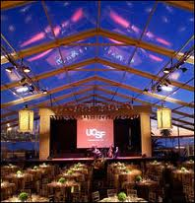
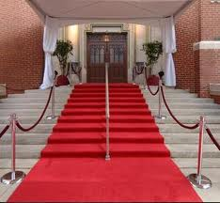
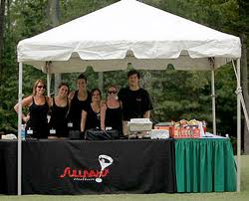
SEM1 1.03 A - Professional Development
PE - Acquire information about the Sport & Event Industry to aid in Career Choices
PI – Explain career opportunities in sport/event marketing

Slide 2
Identify Types of Businesses that offer Careers in Sports/Event Marketing
Teams (College, Professional, Amateur)
Venues (Coordination & Sales)
Sports Agencies
Parks & Rec Departments
Private Businesses
Sporting Goods Industry (Retail, Sales, B2B)
Technology (Websites, Apps, Research)
Media (Radio, TV)
News Industry
Event Planning
Fitness Industry
Agents
Marketing (Marketing Research, Sales)
Public Relations
Charities
Convention and Visitors
Hospitality Services
And many, many more….

Slide 3
Distinguish between Sport Marketing and Event Marketing.
Sports Marketing: the involvement of sports to develop, promote and distribute goods and/or services to satisfy the needs and wants of consumers
Entertainment Marketing: involves entertainment to develop, promote, and distribute goods and/or services to satisfy the wants and needs of customers.
Event Marketing: the designing or developing a “live” themed activity, occasion, display or exhibit (such as a sports, music festival, fair or concert)to promote a product, cause, or organization.

Slide 4
Comparing Sports & Event Marketing
Similarities
Depth and Breath of fields
Employees with a variety of skills and interests
Differences
Event Marketing has broader scope
More job opportunities in Event Marketing
Event Marketing focuses more of business and corporate sponsorships
Social media will continue to be very important in the future

Slide 5
Explain why jobs in Sport/Event Marketing provide Career Potential
Number of fields
Broad opportunities
Good for many different talents and interests
Growing interests in most sectors
People find sports or entertainment careers very engaging

Slide 6
Discuss Personal Traits needed for success in Sport/Event Marketing
Competitiveness
Positive attitude
Problem Solving
Detail Oriented
Leadership
Creativity
Adaptability
Negotiation Skills
Flexibility
Time Management
Able to work under pressure
Multitasking ability
Initiative

Slide 7
Explain Training needed for careers in Sport/Event Marketing
Firm educational background
Marketing
Business
Communications/Social Media
Liberal Arts
Volunteer experiences & Internships

Slide 8
Describe the following Sport/Event Marketing Careers:
Advertising – Print, broadcast & social media
Sales promotion – In stadium, walk-in, season ticket holders & single ticket promotions
Ticket sales – Direct and indirect
Ticket management – Pricing, distribution and logistics
Market research – Know your consumer
Merchandising – Other products to support your main product – display, etc.
Community relations – Public relations within the community to enhance image

Slide 9
Describe the following Sport/Event Marketing Careers
Media relations – Press releases, press kits, answering consumer questions, Twitter, Facebook and You Tube
Sponsorship manager – finding business partner’s with the same target market
Event planner – Coordinates all event aspects
Hospitality manager – Coordinates business clients and consumer hospitality
Volunteer/vendor coordinator – Recruits volunteers to work events and works with vendors
Marketing director – Manages all aspects of the marketing department including all social media, etc.

