Slide 1
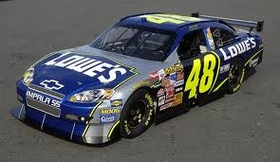
SEM1 1.07 A - Promotion
PE - Employ sales-promotion activities to inform or remind customers of business/product
PI – Explain the nature of sponsorship in the sports/event industries

Slide 2
Define the term Sponsorship
Sponsorship is completed financially or through the provision of products or services to support an event, activity, person, or organization where two or more parties benefit from the arrangement in the form of a partnership. Sponsors want recognition & affiliation
The key to building successful sponsorship programs is to match the correct products or services with the people who want to purchase them – so…it must be your/their target market!
Financing can be in the form of money, products, equipment, services, or any combination of the four

Slide 3
Contrast sponsorship for big versus small organizations
Small organizations may not spend the time to develop good sponsorship programs and they also may provide unrealistic deadlines and have limited staff
Small organizations may have more difficulty communicating with the sponsors and tend to develop sponsor disengagement and lack of follow through

Slide 4
Contrast sponsorship for big versus small organizations
Larger organizations may have staff or be able to hire consultants to develop a good sponsor program and generally communicate more completely
Larger organizations may have unrealistic expectations about their event and expect a higher monetary amount than smaller events – You may get lost in the shuffle

Slide 5
Explain benefits associated with sponsorship activities
Good Public/community relations – improve image
Communicate directly with your target market of consumers
Reach a larger number of consumers through recognition
Increase sales and profits through affiliation & brand awareness
Increase market share or introduce new products
Enter new markets
Entertainment clients, (new and current)
Entertain your employees

Slide 6
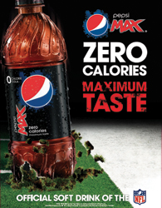
Describe the significance of exclusivity in sponsorships
Must be your target market to be significant
Most sponsors will only sponsor an event if they receive exclusivity for their product line
Example: You will not find Coke and Pepsi sponsoring the same event
Companies are spending money to sponsor an event to reach their target market and wish to avoid confusion
Naming rights cost a lot more and also
offer exclusivity

Slide 7
Discuss ways in which sponsorship relationships are formed – formal contracts
Must be their target market
Communication and develop partnership
Ongoing dialogue to expand relationship
Both parties benefit
Formal contracts spell out exactly what each party will do
Avoid legal conflict
Details include: cost, marketing opportunities, audience demographics, conflicts and time parameters

Slide 8
Risks associated with sponsorships –
Can be expensive
May not hit your target market
The event/individual/organization could create a bad image and your associated with it
Example: Jaguar and Stephanie Rice comments in 2010
Example: Super Bowl wardrobe malfunction in 2003
Could encounter ambush marketing
Ambush marketing is when a company will expose their products/logo at an event without authorization or payment
Example: Coke is a sponsor but Pepsi is outside the event handing out free Pepsi tees or coolies
Example: Company employs airplane/blimp to fly over event and advertise their logo/product

Slide 9
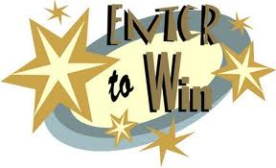
Explain why businesses should exploit their sponsorships
NASCAR claims that many sponsors do not maximize what they can do with their target market at races. Don’t just advertise:
Driver and show car appearances at retail store events
Photo opportunities for consumers/fans
Pit/garage passes and tours during race day
NASCAR driving schools
Employee thank you events and participation
Public Relations opportunities
Contests, sweepstakes, coupons and other promotional tools
Brainstorm and develop opportunities to exploit your sponsorship

Slide 10
