Slide 1
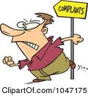
SEM1 1.08 A - Customer Relations
PE - Resolve conflicts with/for customers to encourage repeat business
PI – Handle difficult customers
PI – Handle customer/client complaints

Slide 2
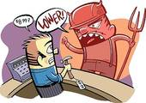
Define the term complaint
Complaint is a customer’s dissatisfaction expressed orally, silently or in writing
Some customers actually express the true reasons
Others do not tell the real reasons
These customers normally conceal the real complaint by stating another believable, but secondary, reason for the dissatisfaction
Example:
Customer returns a pair of shoes due to the color of the shoe but the real reason was the high price
Salesperson must skillfully question and inspect the product to discover the real complaint

Slide 3
Identify the costs associated with customer complaints
Loss of sales – present and future
One dissatisfied customer may tell 10 other potential customers
Damaged image – store, product & sales personnel
Additional recordkeeping - paperwork
Markdowns on returned goods – ½ of returned product is sold but at a reduced prices
Increased interest payments – companies must borrow money to buy goods, more time means less profit

Slide 4
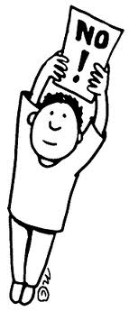
Identify the reasons for customer complaints
Some complaints are justified, while others aren’t
3 major reasons/areas of customer complaints
Products - poor quality, improper labeling or improper buying decisions
Personnel – high pressure, rudeness, insufficient product information, inaccuracy or unsatisfactory service (make sure you determine customer needs and wants)
Business – the # of business or type offered (refusing to accept a credit card) or refusal to accept a return due to policy

Slide 5
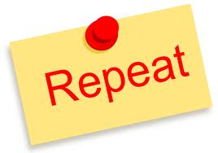
Describe the benefits of customer complaints
Goodwill
Properly settling complaints will promote goodwill
Increased sales
Opportunity to satisfy
May make additional sales
Repeat customers and may tell others
Buying information
Prevention of complaints
Purchasing agent may avoid products with complaints

Slide 6
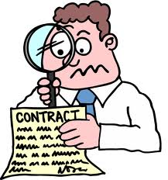
Explain the importance of appropriately handling customer complaints
Should be immediate
Should be effective
Should offer customer satisfaction
Should follow company policy
Should follow company procedure

Slide 7
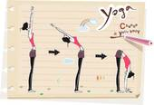
Explain procedures for handling customer complaints
Develop company policy
General rules followed by personnel
Avoids misunderstandings
Apply fair & consistent treatment of customers
Policy goals should be fair and targeted towards customer satisfaction
Develop consistent yet flexible company policies
Management decisions
Sales personnel decisions

Slide 8
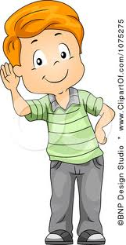
Demonstrate procedures for handling customer complaints
Develop company procedures
Step by step
Listen to ascertain reason
Thank the customer
Restate the complaint
Investigate the problem
Explain company policy
“Not company policy” is NOT an option
Take action
Satisfy the customer!

Slide 9
Types of difficult customers
Disagreeable:
Customers who are unpleasant and hard to help
Often calmed by composed, courteous and efficient sales personnel – let them have their say
• Domineering/superior:
Overly confident customers who feel they know more & are better than the average person – Bark orders
Make them feel in charge & they sell themselves
Dishonest:
Customers who intentionally attempt to avoid paying part or all of the price for a product
Don’t jump to quick conclusions
Follow company policies and procedures

Slide 10
Types of difficult customers
Suspicious:
Customers who doubt or questions everything and may want facts and proof before being convinced something is true.
Perhaps they had a previous bad experience?
Convince them and you create a customer for life
Explain and demonstrate good service
Slow/Methodical:
Customers who require a lot of time to make a purchase because of indecisiveness
Often will be hesitant even when goods/services are wanted or needed – may come back multiple times to conduct research
Sales personnel must be very patient & you don’t want to overwhelm them with too much information

Slide 11
Describe categories of disagreeable customers – how to handle
Argumentative: customers who seem to look for problems, disagree, question or look for error
Ask simple, polite questions
Impatient: customers who show verbally and nonverbally that they do not want to wait
Agree first on common points and get to the point
Leave-me-alone: customers do not want any assistance or advice…mostly retail
Be patient and allow them time alone

Slide 12
Describe categories of disagreeable customers – how to handle
Irritable/Moody: customers who display any attitude making it difficult for the sales personnel
Be positive, upbeat and flexible
Insulting: customers that get frustrated and take it out on the sales person
Remain neutral and professional
Complaining: customers who think everything is wrong
Respect their thoughts and probe for issues

Slide 13
Describe ways in which customers are dishonest.
Always trying to take advantage of employees
Do not pay for products
Theft, pilferage or shoplifting
Purchase goods–use them–and return them
Switch or alter prices
Damage goods and then ask for discounts

Slide 14
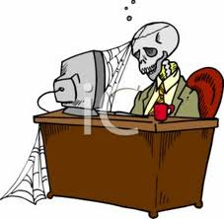
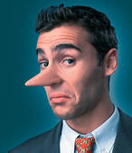
Identify situations in which customers become difficult
Customers want something against company policies.
Problems with merchandise
Broken or damaged items
Lack of need-gift
Wrong size
Changed mind
Problems with company
Account errors-date entry errors
Rude treatment by an employee
Illegal activity
Incompetent employees or service

Slide 15
Explain reasons for handling difficult customers
Customers that have had an issue resolved efficiently and professionally are more loyal.
It is important to gain & retain a customer through superior customer service & build a strong clientele.
Customers are the bread and butter, even the difficult ones.
Word of mouth about professionally handling situations will spread.
It positively impacts the company’s image.
It can aid in development of a competitive advantage.
All of the above contributes to profits.

Slide 16
Demonstrate procedures for handling difficult customers
Interpersonal skills:
Remain calm and in control of emotions
Express patience and flexibility
Listen completely and openly
Courteous and sincere attitude
Provide honest & helpful information
Be respectful to customer needs and not condescending

Slide 17
Demonstrate procedures for handling difficult customers
Communication skills
Speak softly and slowly
Use proper grammar and English and pronounce words correctly and clearly
Listen & respond but do not interrupt customer
Ask appropriate questions to understand issue
Maintain eye contact to show interest
Conversation illustrates employee was examining the situation from customers point of view

Slide 18
Demonstrate procedures for handling difficult customers
Process/Procedure
Recognize type of difficult customer and handle the situation accordingly
Use appropriate techniques for working with that type of difficult customer to handle needs/wants
Customer feels pace and amount of time allotted to their problem was acceptable and left satisfied
Follow company’s policies, explain them completely and clearly while calming customer

